Slide 1

Chapter 3
Determining Feasibility and Managing Analysis and Design Activities
Systems Analysis and Design
Kendall and Kendall
Fifth Edition

Slide 2
Major Topics
Project initiation
Determining project feasibility
Project scheduling
Managing project activities
Manage systems analysis team members

Slide 3
Project Initiation
Projects are initiated for two broad reasons:
  Problems that lend themselves to systems solutions
  Opportunities for improvement through
    Upgrading systems
    Altering systems
    Installing new systems

Slide 4
Organizational Problems
Identify problems by
Check output against performance criteria
  Too many errors
  Work completed slowly
  Work done incorrectly
  Work done incompletely
  Work not done at all

Slide 5
Organizational Problems
Observe behavior of employees
  High absenteeism
  High job dissatisfaction
  High job turnover

Slide 6
Organizational Problems
Listen to feedback from vendors, customers, and suppliers
  Complaints
  Suggestions for improvement
  Loss of sales
  Lower sales

Slide 7
Project Selection
Five specific criteria for project selection
  Backed by management
  Timed appropriately for commitment of resources
  It moves the business toward attainment of its goals
  Practicable
  Important enough to be considered over other projects

Slide 8
Possibilities for Improvement
Many possible objectives exist including
  Speeding up a process
  Streamlining a process
  Combining processes
  Reducing errors in input
  Reducing redundant storage
  Reducing redundant output
  Improving system and subsystem integration

Slide 9
Feasibility Impact Grid (FIG)
A feasibility impact grid (FIG) is used to assess the impact of any improvements to the existing system
Can increase awareness of the impacts made on the achievement of corporate objectives

Slide 10
Feasibility Impact Grid (FIG)
Current or proposed systems are listed on the left
Objectives are listed on the top
Red arrows indicate a positive impact
Green arrows indicate implementation

Slide 11
Feasibility
A feasibility study assesses the operational, technical, and economic merits of the proposed project
There are three types of feasibility:
  Technical feasibility
  Economic feasibility
  Operational feasibility

Slide 12
Technical Feasibility
Technical feasibility assesses whether the current technical resources are sufficient for the new system
If they are not available, can they be upgraded to provide the level of technology necessary for the new system

Slide 13
Economic Feasibility
Economic feasibility determines whether the time and money are available to develop the system
Includes the purchase of
  New equipment
  Hardware
  Software

Slide 14
Operational Feasibility
Operational feasibility determines if the human resources are available to operate the system once it has been installed
Users that do not want a new system may prevent it from becoming operationally feasible

Slide 15
Activity Planning
Activity planning includes
  Selecting a systems analysis team
  Estimating time required to complete each task
  Scheduling the project
Two tools for project planning and control are Gantt charts and PERT diagrams

Slide 16
Estimating Time
Project is broken down into phases
Further broken down into tasks or activities
Finally broken down into steps or even smaller units
Estimate time for each task or activity
May use a most likely, pessimistic, and optimistic estimates for time

Slide 17
Gantt Charts
Easy to construct and use
Shows activities over a period of time

Slide 18
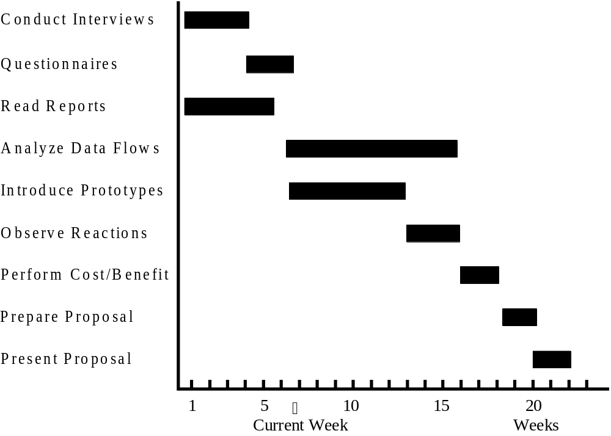
Gantt Chart Example

Slide 19
PERT Diagram
PERT - Program Evaluation and Review Technique
  PERT diagrams show precedence, activities that must be completed before the next activities may be started
  Used to calculate the critical path, the longest path through the activities
  This is the shortest time to complete the project

Slide 20
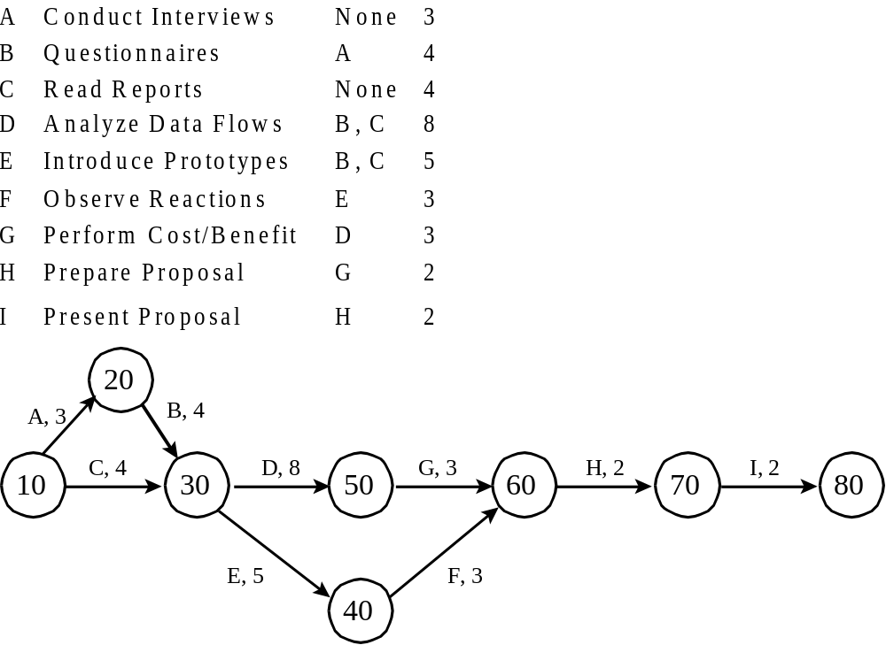
PERT Diagram Example

Slide 21
PERT Diagram Advantages
Easy identification of the order of precedence
Easy identification of the critical path and thus critical activities
Easy determination of slack time, the leeway to fall behind on noncritical paths

Slide 22
Timeboxing
Timeboxing sets an absolute due date for project delivery
The most critical features are developed first and implemented by the due date
Other features are added later

Slide 23
Personal Information Manager Software
Personal information manager (PIM) software is useful for scheduling activities and includes features such as:
  Telephone and fax number lists
  To-do lists
  Online calendars

Slide 24
Team Management
Teams often have two leaders:
  One who leads members to accomplish tasks
  One concerned with social relationships
The systems analyst must manage
  Team members
  Their activities
  Their time, and resources

Slide 25
Goal Setting
Successful projects require that reasonable productivity goals for tangible outputs and process activities be set
Goal setting helps to motivate team members

Slide 26
Ecommerce Project Management
Ecommerce and traditional software project management differences:
  The data used by ecommerce systems is scattered across the organization
  Ecommerce systems need a staff with a wide variety of skills
  Partnerships must be built externally and internally well ahead of implementation
  Security is of utmost importance

Slide 27
Project Failures
Project failures may be prevented by
  Training
  Experience
  Learning why other projects have failed

